Slide 1
Phishing Email Detection using Machine Learning and BERT
From Traditional Models to BERT Fine-Tuning
Team Member:
Suhan Yoon,Jia-Min Li ,Yvette He, Matt Ma,Sam Bokaei Ghomi

Slide 2

Why do we need this system? The Growing Threat of Phishing
84%
Of employees interacted with phishing emails within 10 minutes
Phishing emails are a significant cybersecurity threat
A robust machine learning system to detect phishing emails
We explored various machine learning approaches, progressing from traditional models to BERT fine-tuning.
Notes:
Why do we need this system
Phishing emails are a significant cybersecurity threat. 84% of employees interact with phishing emails within just 10 minutes
Even I received a phishing email this morning and wasn’t sure whether it was a scam or not.
Our project aims to build a robust machine learning system to accurately detect phishing emails.
We explored various machine learning approaches, progressing from traditional models to BERT fine-tuning.

Slide 3

Workflow Overview:
From Raw Emails to Meaningful Features
1. Data Preprocessing:
Removed HTML tags, stop words
Extracted structural features (e.g., number of URLs, char count)
Text features: TF-IDF and BERT sentence embeddings
2. Modelling Steps:
Traditional ML models
DNN on top of BERT
Fine-tuned BERT end-to-end
3. Evaluation Metrics:
Accuracy, Precision, Recall, F1-score, Confusion Matrix
Notes:
In this project, we first cleaned the text data by removing HTML tags and stop words, and extracted structural features like URL count and character length.
For text representation, we used both TF-IDF and BERT embeddings.
We tried traditional machine learning models, then used a deep neural network on BERT, and finally fine-tuned BERT end-to-end for best performance.
To evaluate our models, we used accuracy, precision, recall, F1-score, and the confusion matrix to understand their strengths and weaknesses

Slide 4
Workflow: Progressive modelling pipeline
•Phase 1:
Traditional ML models (Logistic Regression, SVM, Random Forest, Naive Bayes)
•Phase 2:
BERT sentence embeddings + Classical models
•Phase 3:
BERT embeddings + Deep Neural Networks (DNN)
•Phase 4:
BERT Fine-tuning
Notes:
We followed a progressive modelling pipeline
Phase 1: Traditional ML Models: Started with classical algorithms like Logistic Regression, Naive Bayes, Random Forest, and Support Vector Machine (SVM).
Phase 2: BERT Embeddings + Classical Models: Integrated pre-trained BERT embeddings as input for the classical models.
Phase 3: Deep Learning (DNN) with BERT Embeddings: Built Deep Neural Networks on top of BERT embeddings.
Phase 4: BERT Fine-tuning: The most advanced approach, where the BERT model itself was adapted for our specific task

Slide 5
Preparing the Data:
Cleaning & Structural Insights
Text Normalization(Lowercasing all text, removing punctuation and irrelevant numbers, Tokenizing words and removing common "stopwords)
Structural Feature Extraction(Total number of characters. Total number of words. Proportion of uppercase letters. Number of URLs present.)
Textual Features: TF-IDF vs. BERT Embeddings
TF-IDF Features (Traditional Approach -used TF-IDF to identify the 300 most informative words)
A limitation of TF-IDF is that it treats words independently
BERT Embeddings (Advanced Approach):
To overcome the limitations of TF-IDF
768-dimensional semantic vectors for each email
Notes:
For preparing the data, we use 2 main strategies
First Text Normalization
We started by making the email text consistent. This involved:
Lowercasing all text.
Removing punctuation and irrelevant numbers.
Tokenizing words and removing common "stopwords" (like "the", "a", "is").
And next we go for
Structural Feature Extraction:
Beyond just the text, we extracted numerical features that often indicate spam:
Total number of characters.
Total number of words.
Proportion of uppercase letters.
Number of URLs present.
Number of exclamation marks.
After that we use TF-IDF Features
We initially used TF-IDF to identify the 300 most informative words.
But Limitation of TF-IDF is that treats words independently and struggles to capture semantic meaning or context
To overcome the limitations of TF-IDF—which ignores word order and context—we used BERT embeddings.
Specifically, we used the pre-trained bert-base-uncased model to generate rich, 768-dimensional semantic vectors for each email.
We cleaned the text, tokenized it, and extracted the embedding from the token, which represents the whole sentence.
This approach gave our models a much better understanding of context and significantly improved generalization.”

Slide 6
Optimization 1: Traditional models Optimization
Baseline Results – Traditional Models (TF-IDF)
Using TF-IDF + structural features:
Logistic Regression: 95%
SVM: 96% (best among traditional models)
Naive Bayes: 93%
Decision Tree: 92%
Limitations:
TF-IDF lacks semantic understanding
Sparse high-dimensional vectors
Cannot distinguish similar phrases effectively
Notes:
Now we begin with Optimization 1.
We started by training traditional machine learning models using TF-IDF vectors along
with structural features.
The performance results were:
- Logistic Regression: 95%,
- Support Vector Machine, or SVM: 96%, which was the best among these models,
- Naive Bayes: 93%,
- and Decision Tree: 92%.
Despite these promising results, TF-IDF has key limitations. It lacks semantic understanding, creates sparse high-dimensional vectors, and fails to distinguish similar phrases like “urgent update” versus “critical notice.” This led us to try a more semantically aware approach.

Slide 7
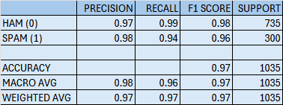
Switching to BERT Embeddings
Why BERT?
Dense, semantic sentence-level embeddings
Better contextual understanding
Implementation:
Used pre-trained BERT to generate embeddings
Reused the same classical models
Tuned hyperparameters for best results
Performance Boost:
Logistic Regression (BERT): 97%
SVM (BERT): 98%
Random Forest (BERT): 95%
Naive Bayes (BERT): 91% (slightly worse due to model assumptions)
Logistic Regression
Notes:
To address these limitations, we switched to BERT embeddings.
BERT generates dense, context-aware sentence-level vectors that better capture meaning.
We used a pre-trained BERT model to extract embeddings from the email text.
We then reused the same classical models and fine-tuned their hyperparameters.
The results improved noticeably:
- Logistic Regression with BERT reached 97%,
- SVM improved to 98%,
- Random Forest got 95%,
- while Naive Bayes dropped slightly to 91%, likely due to its assumption of feature independence.

Slide 8
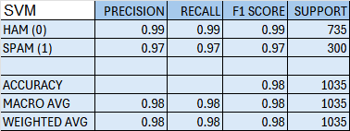
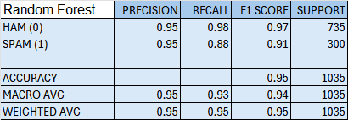
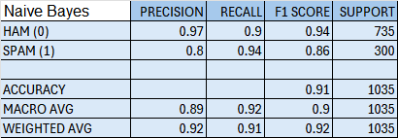
Switching to BERT Embeddings(CONT.)
SVM
Random Forest
Naive Bayes
Notes:
Here we show the confusion matrices and classification.
SVM performed the best, with precision, recall, and F1-score all above 0.98.
Random Forest was strong overall, but its recall for spam dropped to 0.88.
Naive Bayes underperformed with dense embeddings, especially in detecting spam.
These results confirm that BERT embeddings significantly enhance traditional model
performance.

Slide 9
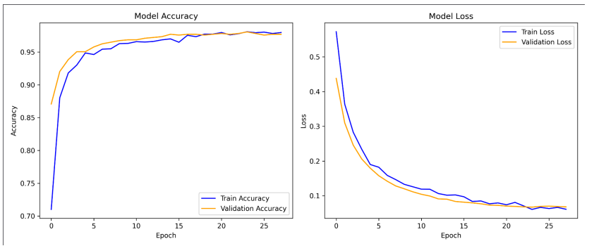
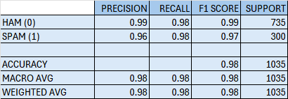
Optimization 2: From Baseline DNN to Optimized DNN
Initial Result: 95% accuracy, but overfitting quickly
Optimizations:
Added Batch Normalization + Dropout (0.3–0.4)
Applied StandardScaler for input normalization
Lowered learning rate (Adam = 1e-4)
Used EarlyStopping and ReduceLROnPlateau
Final Result: ~98.5% accuracy, more stable training
Notes:
Next, we built a Deep Neural Network using BERT embeddings as input.
The baseline DNN achieved 95% accuracy but overfitted quickly.
To address this, we made several optimizations:
We added Batch Normalization and Dropout layers ranging from 0.3 to 0.4,
normalized the input using StandardScaler,
and lowered the learning rate to 2 times 10 to the power of minus 4.
We also added EarlyStopping and ReduceLROnPlateau to stabilize training.
The final result was about 98.5% accuracy with a smooth and stable learning curve.

Slide 10
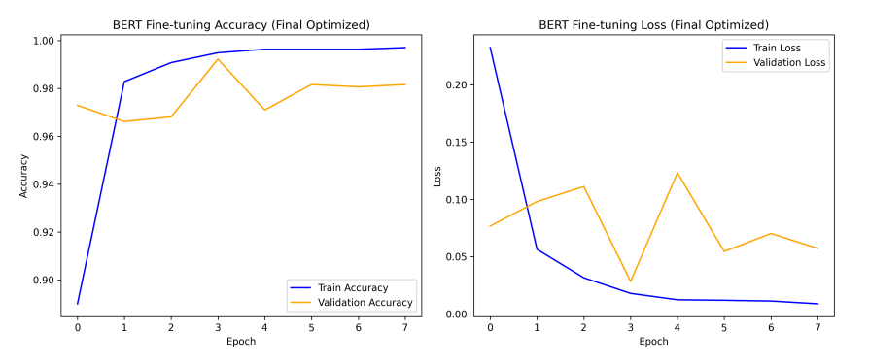
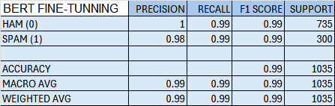
Optimization 3: Full BERT Fine-Tuning
Goal: Let BERT learn phishing-specific semantics
Initial Settings:
Learning rate: 5e-5, 3 epochs → ~98.4%
Final Optimized Setup:
Learning rate: 2e-5
Up to 8 epochs + EarlyStopping (best at 4th epoch)
Batch size: 32, Max sequence length: 128
Saved best model automatically
Final Accuracy: 99.2%
Notes:
Finally, we fully fine-tuned the BERT model
to help it learn phishing-specific language patterns directly.
We started with a learning rate of 5 e minus 5
and trained for 3 epochs, which gave us 98.4 percent accuracy.
After further tuning —we lowered the learning rate to 2 e minus 5,
increased training to up to 8 epochs with EarlyStopping, and set the batch size to 32.
This gave us the best result.
The final model reached 99.2 percent accuracy,
with perfect precision on legitimate emails,
and 0.99 precision on phishing emails.
This shows that fine-tuning BERT was highly effective for this classification task.

Slide 11
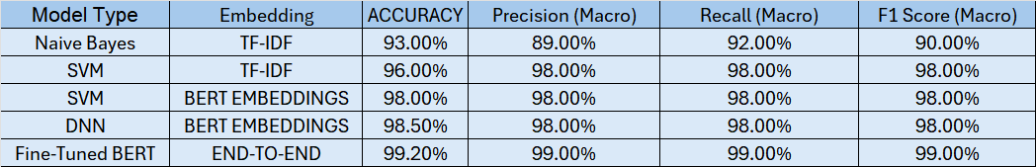
Model Comparison Table
Notes:
This table summarizes all the model performances:
- Traditional SVM with TF-IDF scored 96%,
- SVM with BERT improved to 98%,
- The optimized DNN with BERT embeddings reached 98.5%,
- And the best-performing model was the fully fine-tuned BERT at 99.2%.
These results highlight how semantic understanding substantially improves phishing detection.

Slide 12
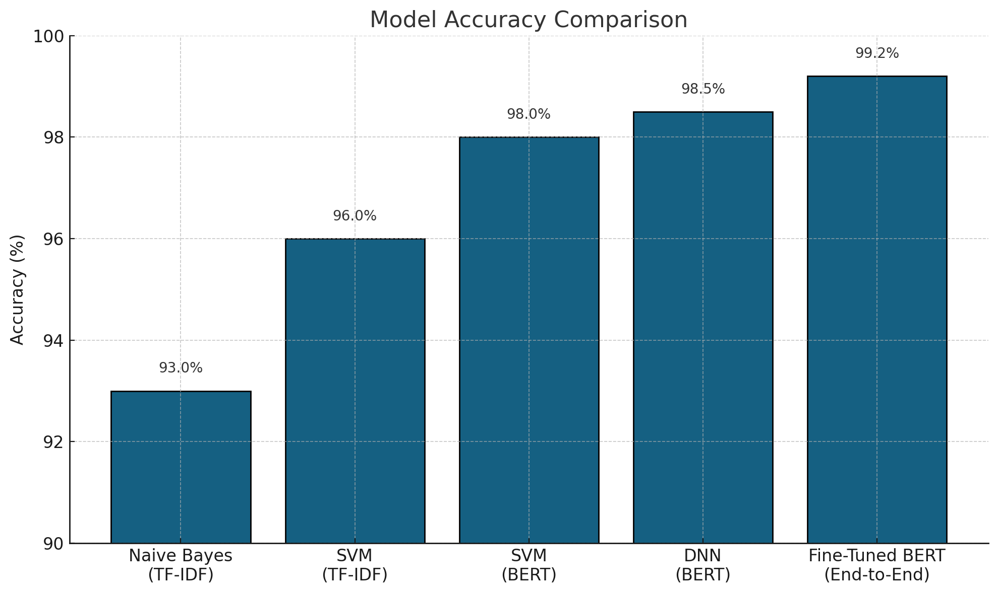
Model Comparison Table Bar Chart
Notes:
This bar chart visually compares model accuracies. You can clearly see the performance gains from TF-IDF to BERT-based methods. Traditional models were around 95–96%, but using embeddings allowed us to break through to above 98%.

Slide 13
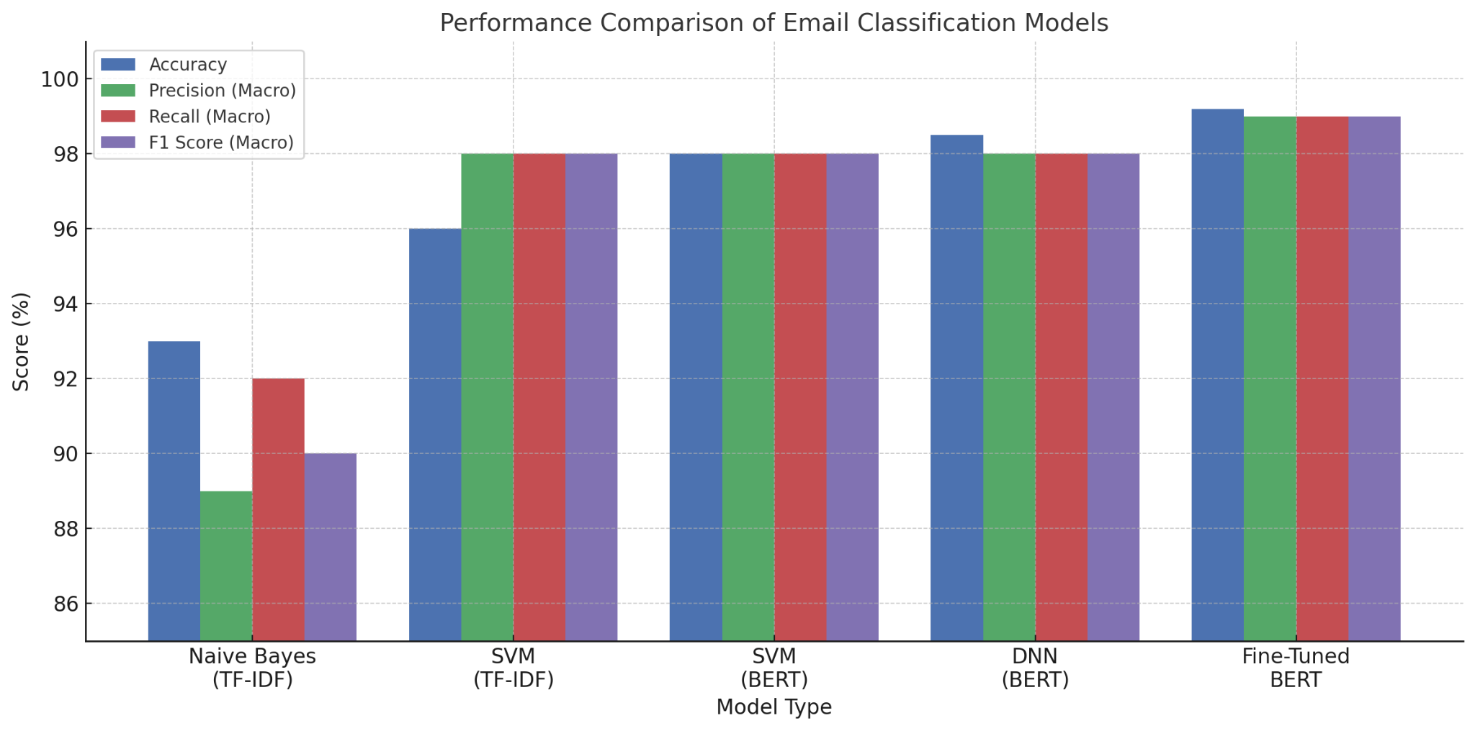
Model Comparison Table Bar Chart
Notes:
Here we focus only on the BERT-based approaches:
- Classical models using BERT embeddings,
- The optimized Deep Neural Network,
- And the fully fine-tuned BERT model.
This shows the incremental improvements, with fine-tuning offering the highest accuracy
at 99.2%.

Slide 14
Key Findings
Traditional ML models already achieved >90%accuracy.
Replacing TF-IDF with BERT embeddings improved semantic understanding, pushing accuracy to 98%.
DNN with BERT embeddings improved slightly to 98.5%.
BERT Fine-tuning achieved 99.2%, confirming the strong semantic representation power Of BERT
Notes:
To summarize our findings:
Traditional models are efficient but limited by TF-IDF.
BERT embeddings significantly improve semantic understanding.
Fine-tuning BERT gave us the best results, especially in detecting hard-to-classify
phishing messages.
SVM and DNN with BERT both performed competitively, with fine-tuning pushing us to the top.

Slide 15
Possible future work
Try more epochs or learning rate scheduling for BERT fine-tuning to approach 99%+.(done)
Experiment with RoBERTa or DistilBERT for efficiency.
Deploy as a CLI tool or web service for real-time phishing detection
Notes:
For future improvements, we see three main directions:
First, fine-tuning BERT with more epochs or advanced learning rate scheduling.
Second, we’d like to experiment with lighter models for faster
and more efficient inference.
Third, we plan to deploy the system as a command-line tool or web service to enable
real-time phishing detection in practical environments.

Slide 16
Thank You for watching!

